Slide 1
Code-Comment Generator
FINAL PRESENTATION
Wang Hongtao, Shao Zherui, Zong Jiulin

Slide 2
Team members
Wang Hongtao – A0195158U
Shao Zherui -- A0231482L
Zong Jiulin -- A0231352U

Slide 3
Menu
Background & Business Problem
Datasets
Code-to-Comment
Comment-to-Code
Name Generation
RASA

Slide 4
Background
Code comments help developers understand programs and reduce extra time spent reading and navigating source code.
These annotations are often mismatched, missing, or outdated in software projects.
Many programmers don't know how to name variables or write comments based on code

Slide 5
Business problem statement
Developing systems that can assist programmers or even generate programs independently could make programming more productive and accessible
Large-scale language models have demonstrated an impressive ability to generate code, and are now able to complete simple programming tasks [1]
Scalable sequence prediction models have become a general-purpose method for generation and representation learning in many domains, generating natural language to code is now achievable [2].
Notes:
bottom feature map of CNN is close to the image texture and the high-level feature map is close to the natural characteristics of the image content.

Slide 6
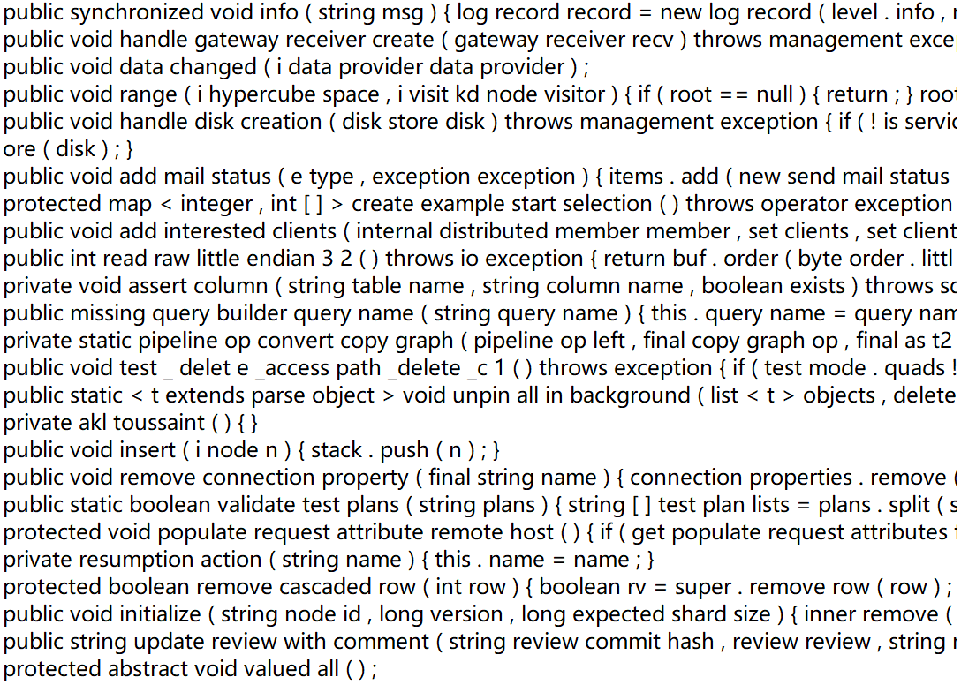
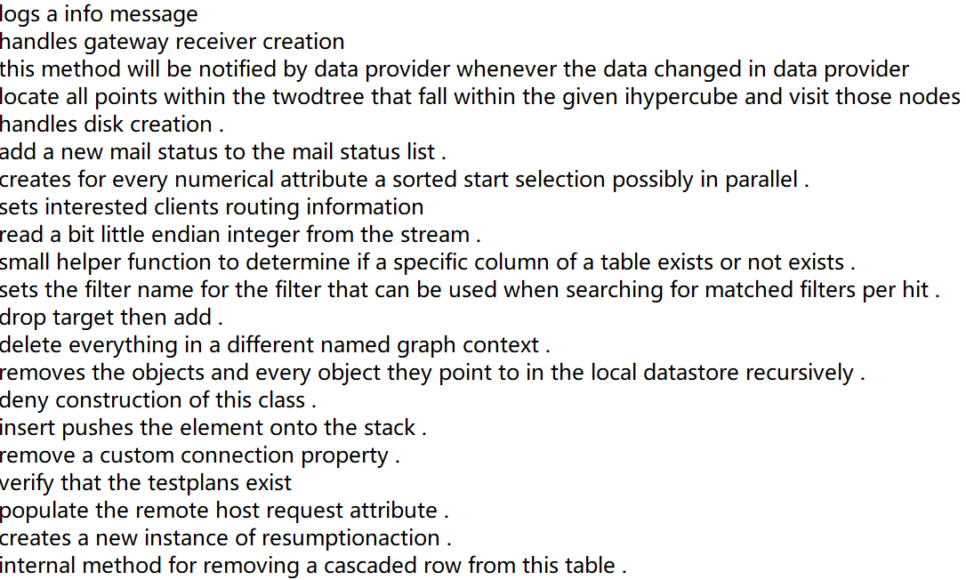

Dataset
EMSE-DeepCom [3]:
Java projects from github
Each line of code corresponds to a line of comment
Too large and require too much training time
Pick out 500,000 lines [4]
Codes
Comments

Slide 7
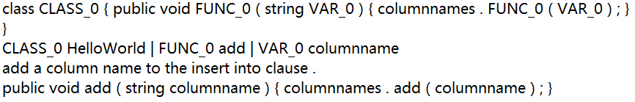
Dataset
Masked-Codes:
Picking out preprocessor from Facebook codegen.
Implementing obfuscation on Java codes, and use FUNC, VAR to replace original function name and variable name.
Adding class name to get the complete class.
The dataset includes original function, obfuscated function, comments and corresponding name dictionary.
Example structure of Dataset
Notes:
Introduce Facebook CodeGen, which is a library for programming language preprocessing
We use its preprocessor to confuse the Java language, and use func and VaR to replace the original function name and variable name
The principle of obfuscation is based on treesitter (see the paper for an introduction)
This function requires complete Java, so we add class HelloWorld to the dataset
Our data set is generated from the original data set, generating 500000 data. Our data set format is TXT, including: original function, confusion function, comment, corresponding name dictionary

Slide 8
Dataset
TreeSitter [6]:
General enough to parse any programming language.
Fast enough to parse on every keystroke in a text editor.
Robust enough to provide useful results even in the presence of syntax errors.
Dependency-free so that the runtime library can be embedded in any application.
Notes:
Tree-sitter is a parser generator tool and an incremental parsing library. It can build a concrete syntax tree for a source file and efficiently update the syntax tree as the source file is edited. Tree-sitter aims to be:
General enough to parse any programming language
Fast enough to parse on every keystroke in a text editor
Robust enough to provide useful results even in the presence of syntax errors
Dependency-free so that the runtime library (which is written in pure C) can be embedded in any application

Slide 9
Training Process and Model Details

Slide 10
Library and Pretrained Models
Tensorflow
Pytorch
TensorboardX
Transformers
BertModel
T5

Slide 11
Code to Comment
Input: Java Code
Output: Comment
Add start token and end token
Build Tokenizer
Tokenize the texts into integer tokens
Train the network

Slide 12
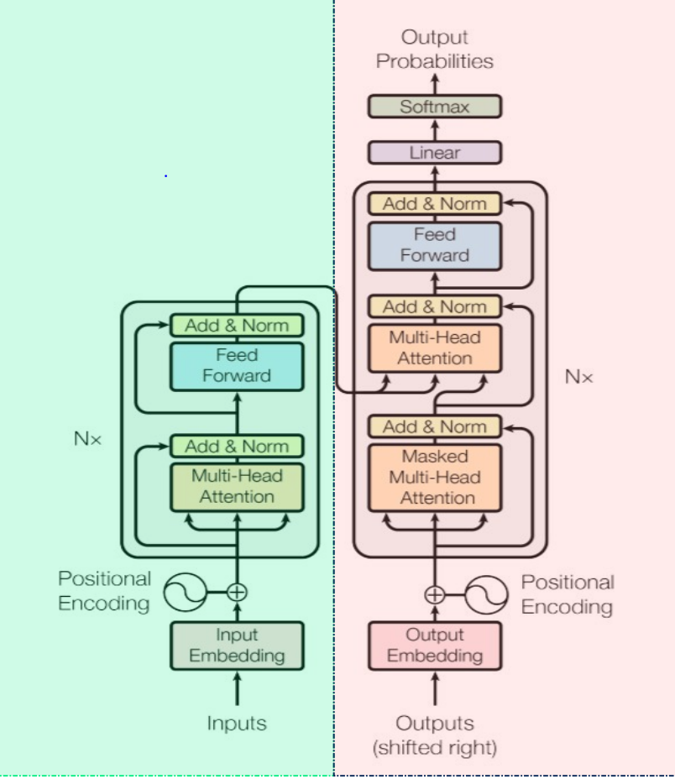

Slide 13
Comment to Code
Transfer learning techniques
Fine Tuning T5
Failed because T5 tokenizer could not generate special tokens in Java code.

Slide 14
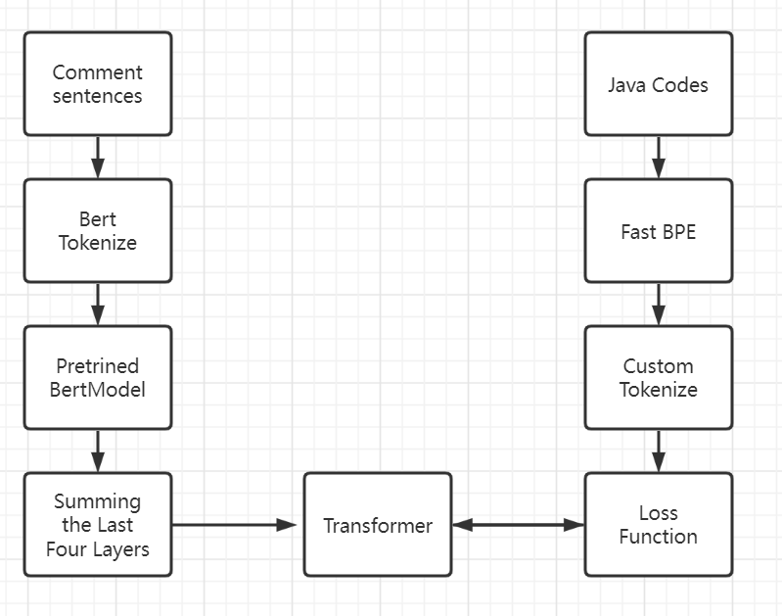
Comment to Code
Bert Word Embeddings + Transformer

Slide 15
Function/Variable Name Generation
Input: Java Codes with Corresponding Comments
Output: Fake name and Real name pairs
Problem:
Names are usually Compound words which are not included in the dictionary of tokenizer

Slide 16
Subward
Byte Pair Encoding
fastBPE
Codes and Vocabulary for fastBPE are download from Facebook CodeGen. They were learned on C++, Java and Python.

Slide 17
Structure of RASA

Slide 18
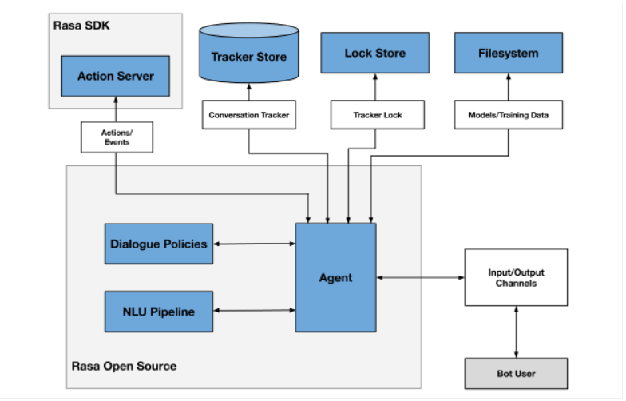
RASA
We use RASA as our project chatbot.
Below is the overview of RASA architecture.
Notes:
Two primary components are Nlu(natural language understand) and the dialogue management
NLU is the part that handles intent classification, entity extraction, and response retrieval. It's shown below as the NLU Pipeline because it processes user utterances using an NLU model that is generated by the trained pipeline.
The dialogue management component decides the next action in a conversation based on the context. This is displayed as the Dialogue Policies in the diagram.

Slide 19
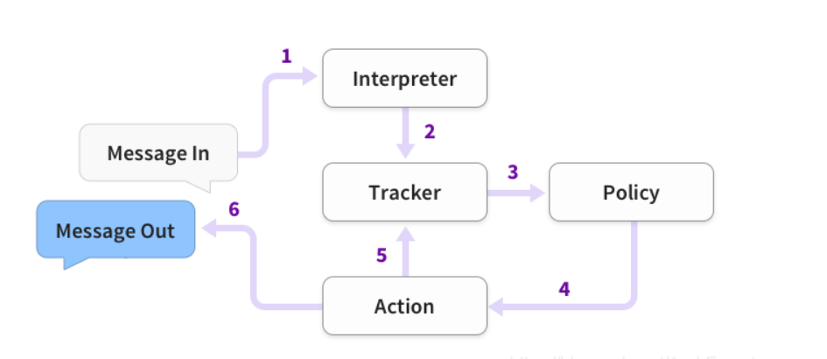
RASA
Message Handling:
This diagram shows the basic steps of how an assistant built with Rasa responds to a message:
Notes:
The message is received and passed to an Interpreter, which converts it into a dictionary including the original text, the intent, and any entities that were found. This part is handled by NLU.
The Tracker is the object which keeps track of conversation state. It receives the info that a new message has come in.
The policy receives the current state of the tracker.
The policy chooses which action to take next.
The chosen action is logged by the tracker.
A response is sent to the user.

Slide 20
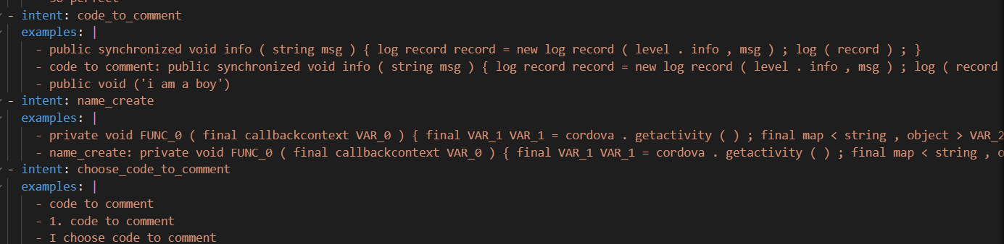
RASA
NLU
Rasa NLU is an open-source natural language processing tool for intent classification, response retrieval and entity extraction in chatbots. For example, taking a sentence like
"I am looking for a Mexican restaurant in the center of town"
and returning structured data like
{
"intent": "search_restaurant",
"entities": {
"cuisine" : "Mexican",
"location" : "center"
}
}

Slide 21
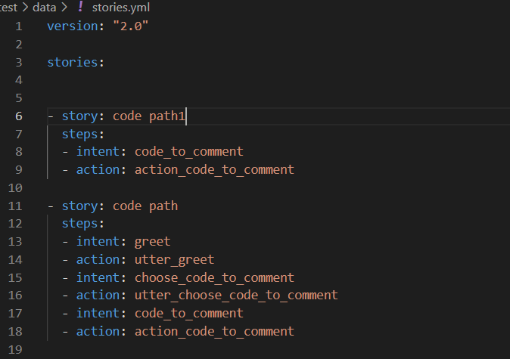
RASA
Stories
Rasa stories are a form of training data used to train the Rasa’s dialogue management models.
A story is a representation of a conversation between a user and an AI assistant, converted into a specific format where user inputs are expressed as corresponding intents (and entities where necessary) while the responses of an assistant are expressed as corresponding action names.

Slide 22
RASA
Domain
The domain defines the universe in which your assistant operates. It specifies the intents, entities, slots, responses, forms, and actions your bot should know about. It also defines a configuration for conversation sessions.

Slide 23

Demo

Slide 24
References
Li, Y., Choi, D., Chung, J., Kushman, N., Schrittwieser, J., Leblond, R., ... & Vinyals, O. (2022). Competition-Level Code Generation with AlphaCode. arXiv preprint arXiv:2203.07814.
Chen, M., Tworek, J., Jun, H., Yuan, Q., Pinto, H. P. D. O., Kaplan, J., ... & Zaremba, W. (2021). Evaluating large language models trained on code. arXiv preprint arXiv:2107.03374.
Hu, X. (2022). GitHub - xing-hu/EMSE-DeepCom: The dataset for EMSE-DeepCom. Retrieved 9 April 2022, from https://github.com/xing-hu/EMSE-DeepCom.
Chen, F. (2022). GitHub - 2017040264/Code-Summarization: My graduation task.The goal is : Give you code,give me comment. Retrieved 9 April 2022, from https://github.com/2017040264/Code-Summarization.
Roziere, B., Lachaux, M. A., Szafraniec, M., & Lample, G. (2021). DOBF: A deobfuscation pre-training objective for programming languages. arXiv preprint arXiv:2102.07492.
Brunsfeld, M. (2022). GitHub - tree-sitter/tree-sitter: An incremental parsing system for programming tools. Retrieved 12 April 2022, from https://github.com/tree-sitter/tree-sitter.

